Slide 1
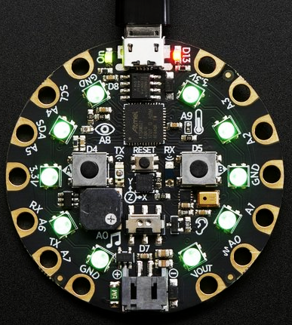
#include <EpicTeamName.h>
// Jarod Gill
// Charles Hingst
// Ashley Poppinga
// Logan Swayne

Slide 2
Simon!
// Pocket-sized memory skill game using Circuit Playground Express (CPX)
// Hours of fun! (depending on your attention span)
// Tap the correct color pattern to win
victory light display

Slide 3

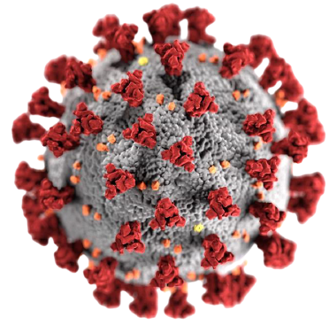
Problem Statement
// Quarantine boredom strikes again!
// Hours in isolation = increased risk of anxiety, depression
// depression = no bueno
sad.jpg

Slide 4
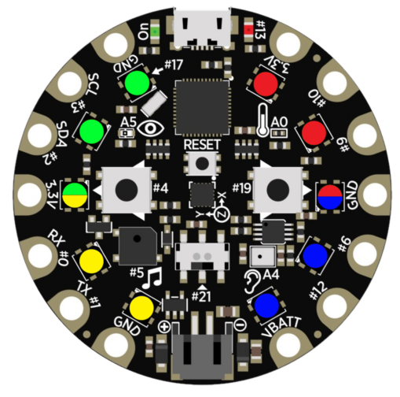
Strategy
// Outlined core functionality
>> Made sure it’s playable
// Added features one at a time
>> Made it cool
// Tweaked sound, light, difficulty functions
>> Made it fun
assigned color quadrants

Slide 5
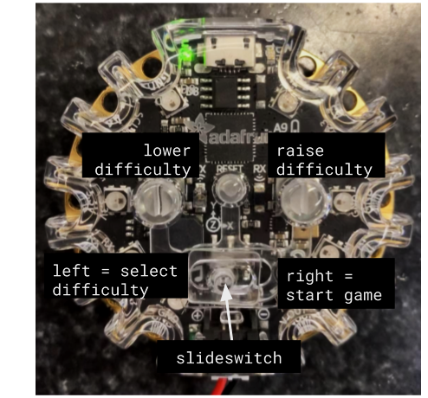
Solution - Features
// LED indication & action-specific sounds
>> Startup, tapping quadrants, if you win :) or lose :(
// 10 Difficulty settings
>> Speeds up pattern display time & adds 1 to sequence length
>> Use slide switch and buttons to select difficulty or start game

Slide 6
Solution - Gameplay
// Select desired difficulty
// Press left & right buttons to start
// 4 color quadrants
// Random color sequence displayed
// Tap capacitor(s) of desired quadrant
// Match the sequence to win!
<< displays pattern
touch corresponding capacitor quadrant >>

Slide 7
Status
// Coding complete, ready for demo!
// Main roadblocks:
>> Refining features to make game more enjoyable
>> Accomplished through testing w/ trial and error
>> Addition of time constraint
>> Struggled running multiple constraints simultaneously

Slide 8
Demonstration!
Questions?

Slide 9
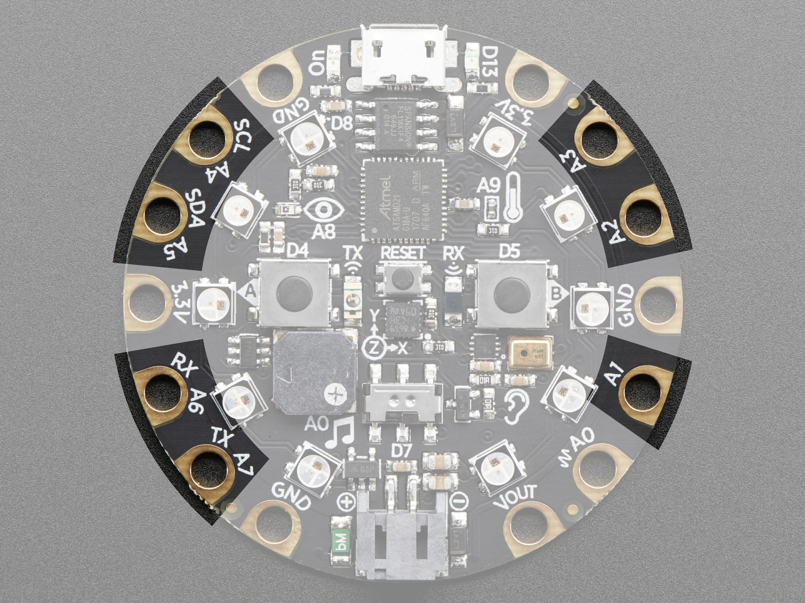
Capacitive Touch
// Total of 7 capacitive touch sensors
>> Quadrant 1: A4 and A5
>> Quadrant 2: A6 and A7
>> Quadrant 3: A1
>> Quadrant 4: A2 and A3

Slide 10
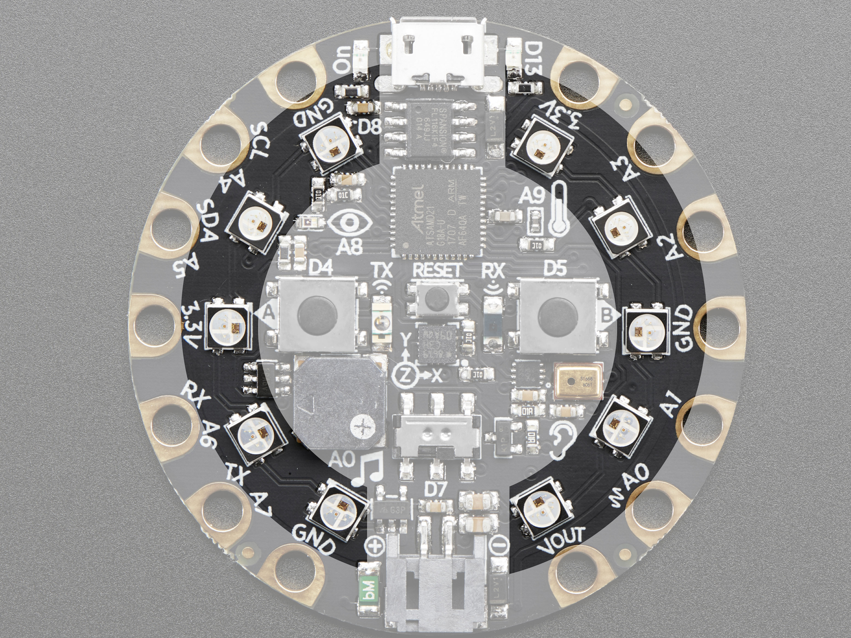
LEDs
// Total of 10 LEDs
// Starting in the upper left and going counterclockwise:
>> Quadrant 1: LED 1,2,3
>> Quadrant 2: LED 3,4,5
>> Quadrant 3: LED 6,7,8
>> Quadrant 4: LED 8,9,10

Slide 11
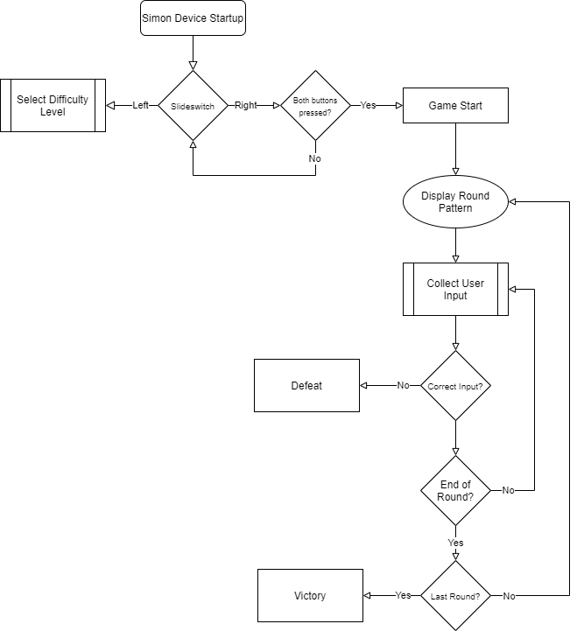
Gameplay Diagram

